Slide 1
Memfractor: a common mathematical framework for electronic circuit elements with memory
René Lozi
Laboratory J.A. Dieudonné, University of Nice-Sophia Antipolis, France
Common work with
Mohammed-Salah Abdelouahab
University of Mila, Algeria
and
Leon O. Chua
Université de Berkeley, USA and Imperial College London, UK

Slide 2
The Memristor : the missing fourth element
43 years ago in his genuine paper “Memristor-the missing circuit
element," IEEE Transactions on Circuit Theory,18, 507-519,
[1971] , L.O. Chua predicted from a
theoretical point of view, the existence
of a missing passive circuit element
in generic electrical circuits componed
of resistor, capacitor and inductor.
He called this element memristor.
Such a physical device would not be
reported until 2008 when a physical Image of 17 nano-memristors
model of a two-terminal hp device at from HP laboratories
nano-scale, behaving has a memristor
was announced.

Slide 3
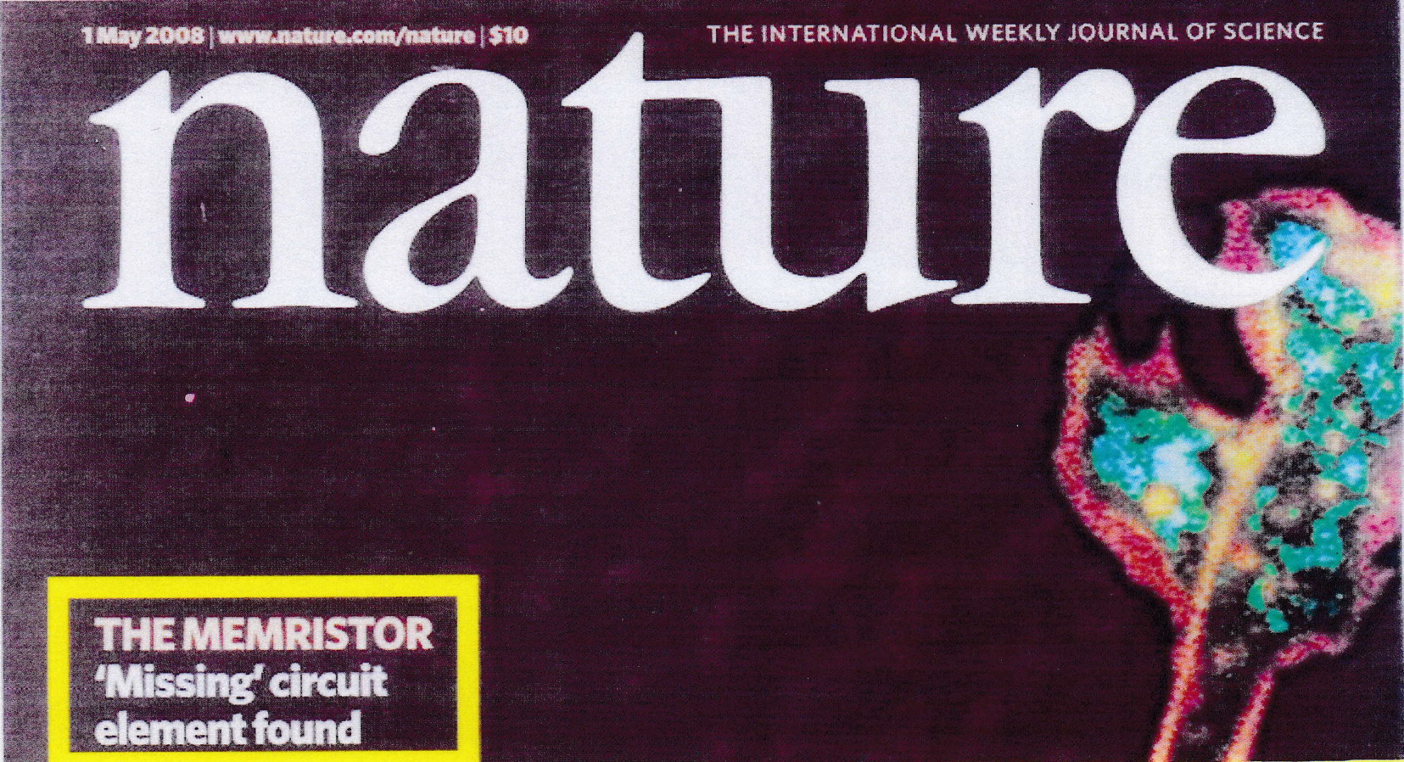
1 May 2008

Slide 4
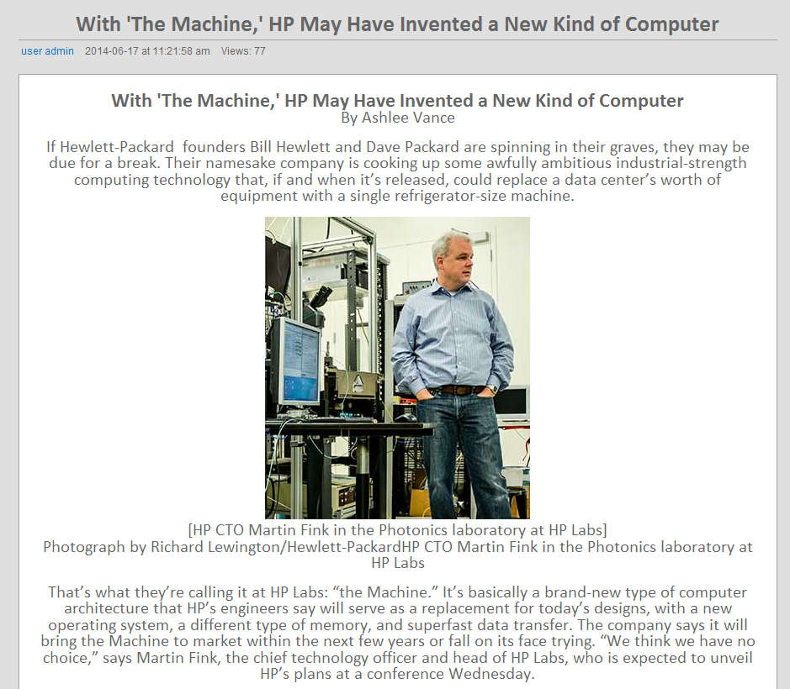
"The Machine"

Slide 5
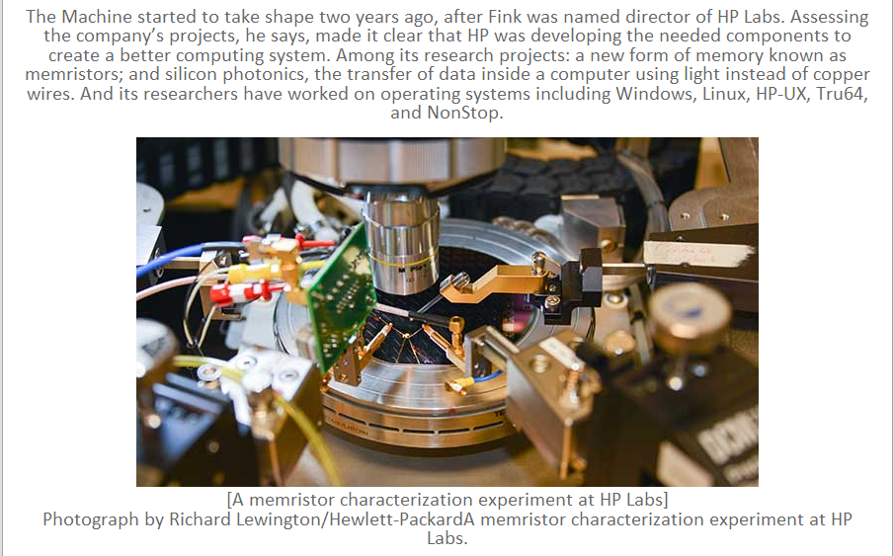
"The Machine"

Slide 6
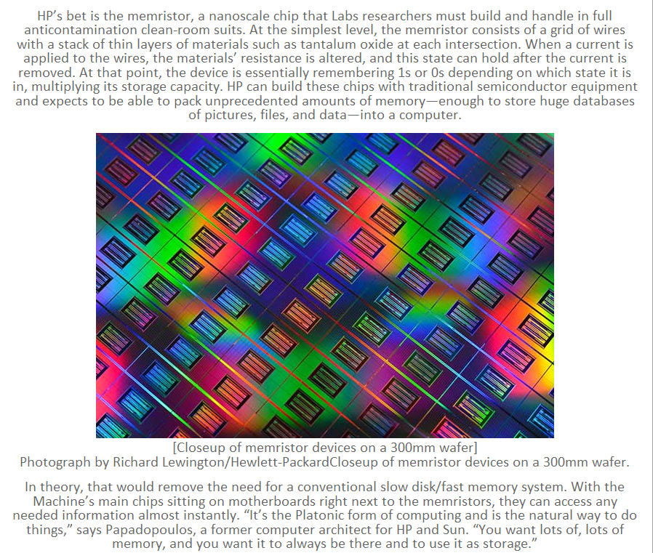

Slide 7
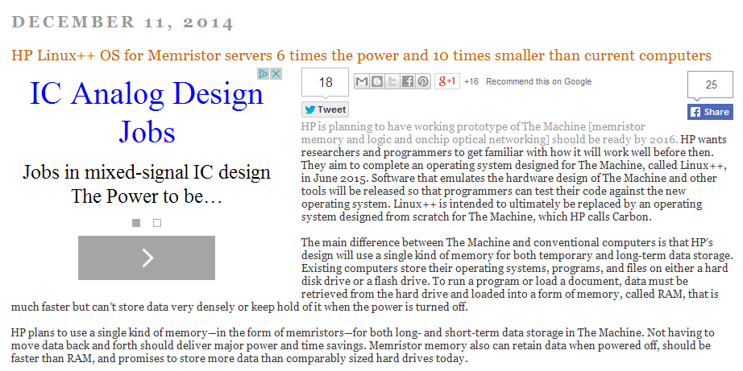

Slide 8
Back to the Ohm’s law(s)
The voltage V standing between the poles of a battery in an electric
circuit with a resistor R, is linked to the intensity I of the current going
through the circuit by the famous Ohm’s law which any student learns
during physics lectures in any high school:
V = RI
Die galvanische Kette, mathematisch bearbeitet (1827)
When the voltage varies with respect to the time this relationship reads
If there is an inductor L instead of a resistor the relationship between
voltage (also called potential) and intensity reads:

Slide 9
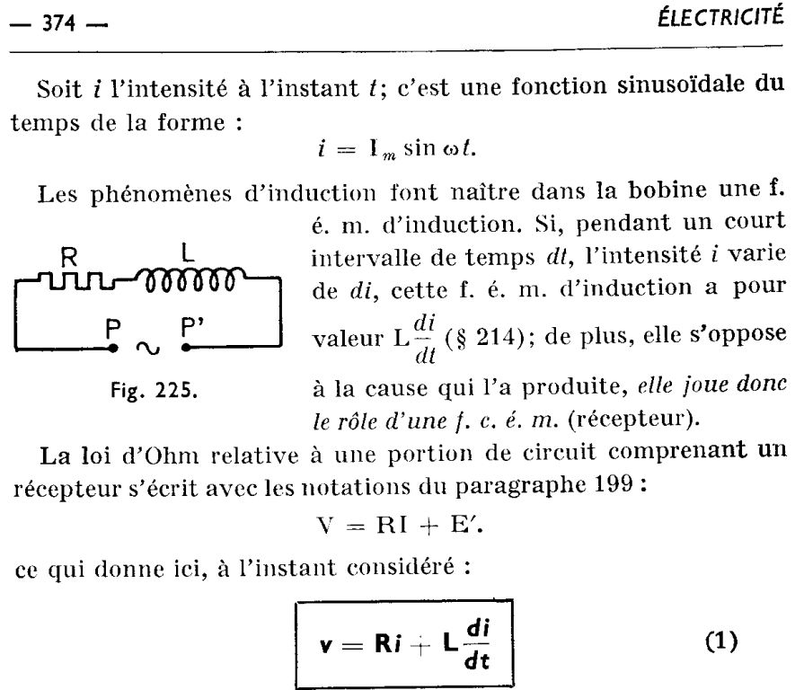
Example of my physics’ handbook in 1967 in « Terminale
Math élem »

Slide 10
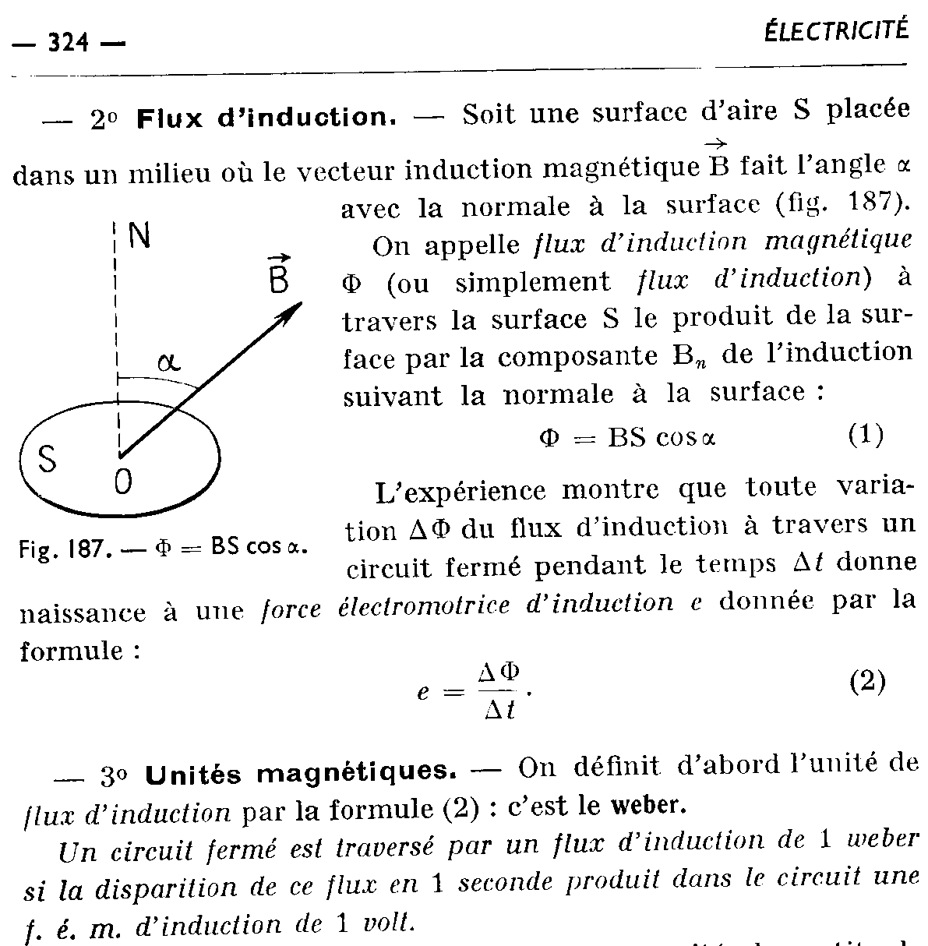
Magnetic
Flux Physical origin interaction between magnetic field and the shape of the electrical circuit
Mathematical definition integral of the electrical potential (voltage) with respect to the time or

Slide 11
Ohm’s law(s)
By integrating with respect to the time the Ohm’s law:
We get
We consider now the third classical passive element of electrical circuit:
the Capacitor.

Slide 12
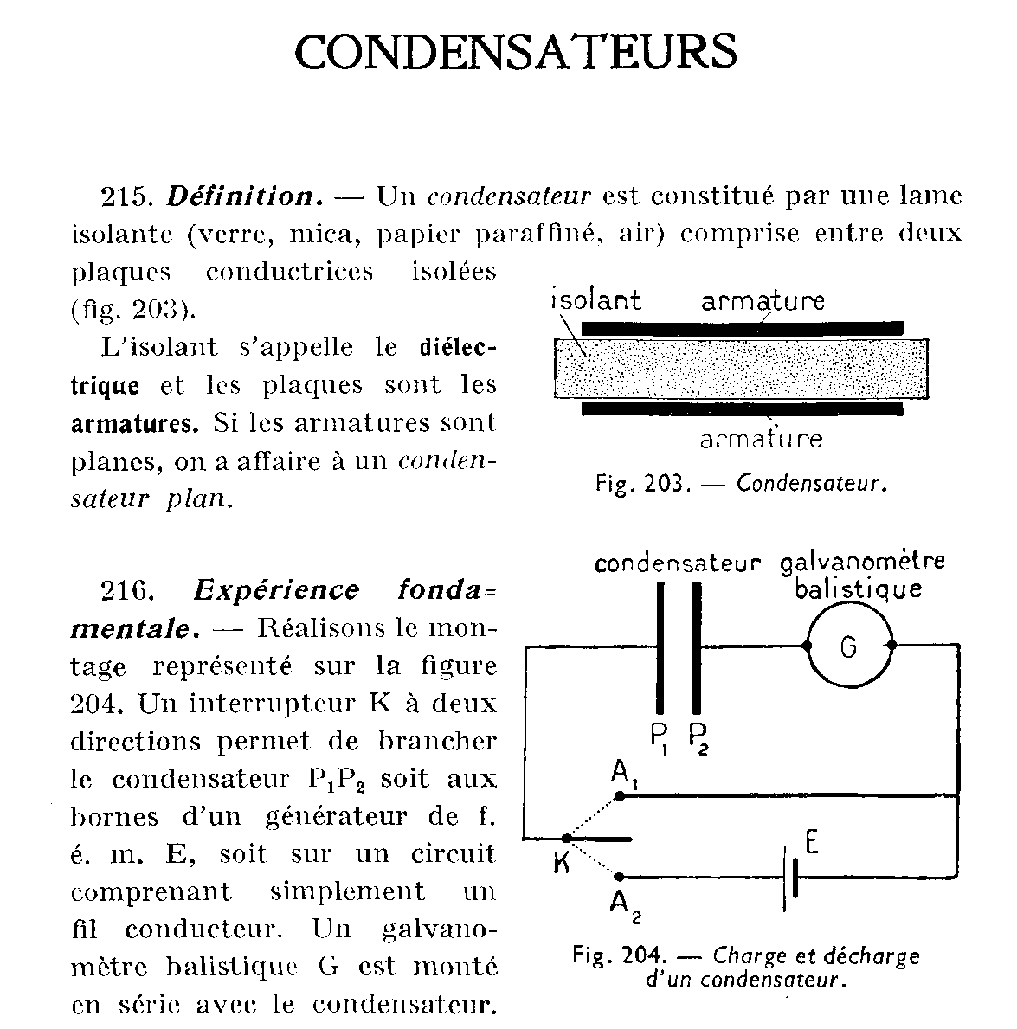
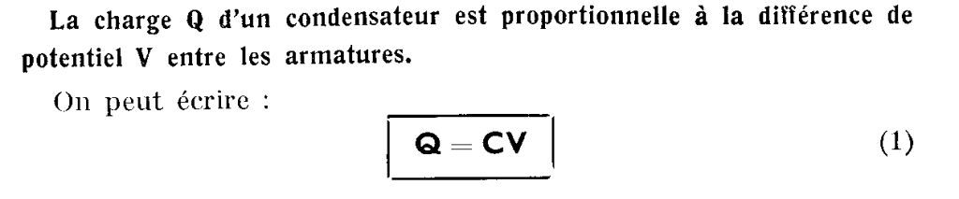
CAPACITOR The relationship between voltage and intensity for a capacitor with C as capacity is which reads also, considering the charge q(t) :

Slide 13
The Memristor : the missing fourth element
In 1971, L.O. Chua, building
this chart flow, showed that
Resistor, Capacitor and
Inductor give a relationship
on each of the three sides
of the square.
Henceforth a relationship
was missing on the upper
side of the square, linking
flux and charge, i.e.

Slide 14

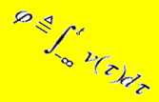
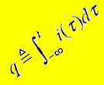
Resistor dissipates
Thermal Energy
voltage, Volt V
current, Ampere A
v
i
R(v,i)=0
R
Capacitor
Stores
Electric Energy
Inductor
stores
Magnetic Energy
L(ϕ, i)=0
C(q,v)=0
C
L
M
q
φ
Memristor
Stores Information
charge, Coulomb C
flux, Weber Wb

Slide 15
Memristor
Axiomatic Definition of the Memristor
i
+
v
̶
Memristor is defined by
a
State-Dependent
Ohm’s law

Slide 16
Experimental Definition of the
i
Memristor
+
v
̶
If it’s Pinched
It’s a
Memristor
i(mA)
v(V)

Slide 17
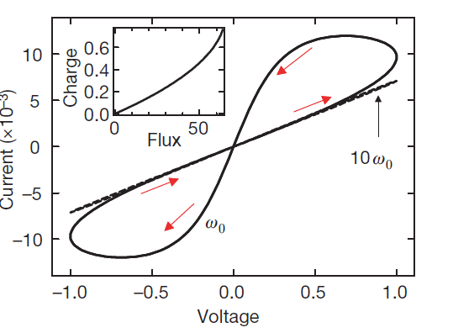
The HP Memristor
i
i (mA)
+
Pt-2
TiO_{2-x}
v (V)
v
0
TiO₂
Pt-1
̶

Slide 19
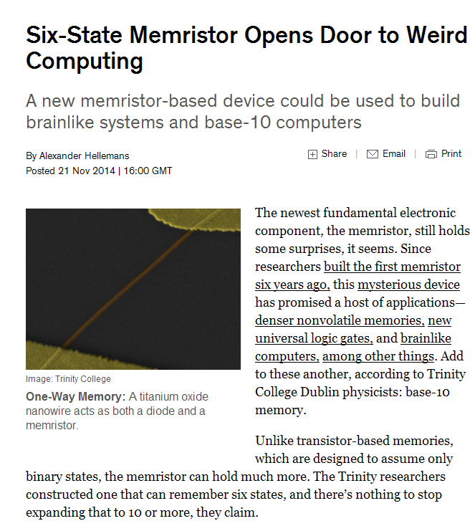
Weird computer using base-10 instead of base-2 number ?

Slide 20
Unification of the laws Ohm’s laws using fractional derivatives

Slide 21
Fractional derivatives and Fractance
If we consider the set of the three Ohm’relationships, it appears that
they involve: 1 the integral of intensity, 2 the intensity and
3 the derivative of the intensity.
Introducing fractional derivative which
is a kind of interpolation between the order of the derivatives we can
summarize and generalize thoses laws in only one,creating a new
mathematical object: the Fractance
which represents either a resistor, an inductor or a capacitor
It is possible to generalize the Ohm’s law:

Slide 22
Fractional derivatives
The idea of fractional calculus has been known since the development of the regular calculus and it means a generalization of integration and differentiation to arbitrary order. There exist several definitions of the fractional derivatives known since centuries:
(the first example is a letter from Liebniz to the french mathematician L’Hospital in date of September 30, 1695, about the existence of the half-order derivative).
They are used for modelling numerous physical systems: dielectric polarization, visco-elastic systems, electrode-electrolyte polarization, …
In this presentation we consider both the Riemann-Liouville and the Caputo’s definition (1967).
We will use also the Grünwald-Letnikov’s definition for numerical simulations.

Slide 23
The Riemann-Liouville definition
Using the classical Gamma function
which verifies
It is possible to write also this definition:
where is the integral Riemann-Liouvile operator

Slide 24
Caputo’s definition
Remark: Caputo’s definition as well as Riemann-Liouville’s one are
depending upon a parameter a because fractional derivatives are
non-local and show a memory effect
which can be also written
In both definitions ,
Those definitions are equivalent under some conditions.
Fractional derivatives have also special relationships with the Laplace transform as for example:

Slide 25
Examples of fractional derivative (Caputo’s definition)

Slide 26
Examples of fractional derivative (Caputo’s definition)

Slide 27
Fractance (integer exponent)
It is possible to unify the Ohm’s laws setting:
and
we obtain, with n = -1, 0,1
The term fractance was coined by A. le Mehaute and G. Crepy in 1983.

Slide 28
Fractance (fractional exponent)
If we consider now for
the fractional derivatives previously defined. We choose the Riemann-
Liouville’s definition with a zero origin, that is we consider that
In order to generalize
we apply the Laplace
transform to both sides
We obtain the impedance
In the case where of is real this define the fractance
We use the Inverse Laplace transform to obtain

Slide 29
Fractance : actual realization
Electric circuit explicitly built in order to proof the existence of a fractance element with s = 1/2

Slide 30
Generalized law of Fractance
One can write again the previous equations under the new form:
Which can be represented as a single equation
or with

Slide 31
Generalized law of Fractance
If the equation stands for a resistor,
if there is a capacitor,
if there is an inductor.
For arbitrarily chosen between 0 and 1 there is a fractor
device.
All those equations can be represented by the following the general
chart flow

Slide 32
Generalized Fractance (chart flow)

Slide 33
Memfractance

Slide 34
Memristor, memcapacitor, meminductor
A memristor is a resistor which is variable with respect to the time,
depending on the quantity of the electric charge which was passed
through it (since a given initial time) :
instead of , we have as for example
In 2009, after the discovery of the H.P. Lab. L. O. Chua generalized
the idea of memory element to two other elements: the memcapacitor
and the meminductor

Slide 35
Memristor, memcapacitor, meminductor
A memristor is a resistor which is variable with respect to the time,
depending on the quantity of the electric charge which was passed
through it (since a given initial time) :
In the same way we define a memcapacitor
Example:
and a meminductor
Example:

Slide 36
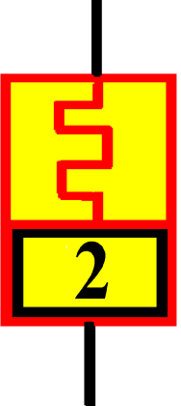
2nd order Memristor
A 2nd order memristor is a new element which extends the memresistor
principle in order to connect the integral of the flux :
to the integral of the charge:
We set
With for example
The relationship between both quantities is:

Slide 37
Memfractance: generalized constitutive relations
We can unify the previous definitions of
in only one:
The aim: it is possible to proof that Ohm’s laws apply to 1st and 2nd memristor, meminductor, memcapacitor.
We know that

Slide 38
Memfractance (Ohm’s laws)
It is possible to rewrite the previous equations under the form of
relationship betweeen flux and charge:
which can be summarized under the form of a single equation
This equation can be generalized in the case where are arbitrary
real numbers belonging between 0 and 1.
We call Memfractance and Memfractor any electrical device
which exhibits a memfractance.

Slide 39
Memfractance
If the equation stands for a memristor,
if it is a memcapacitor,
if it is a meminductor,
If it is a 2nd order memristor,
For any between 0 and 1 it is a memfractor.
All those equations can be represented by the following the general
chart flow:

Slide 40
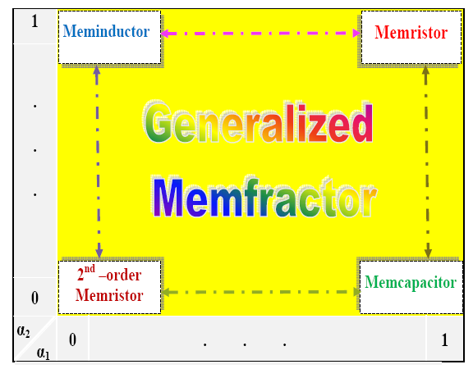
Generalized Ohm’s law for memory elements

Slide 41
Generalized Ohm’s law for memory elements
Proposition: The voltage across a memfractance element is given by the
relation
which reads also as:
Proposition (Generalized Ohm's Law):
The voltage across a memfractance element can be expressed by the relation
This Generalized Ohm’s law for memory elements can be proved in the domain
Remark 3.3. Ohm's Law in magnetohydrodynamics is also called generalized Ohm's Law [Szabo & Abonyi, 1965].
We can represent this relation in the following chart flow

Slide 42
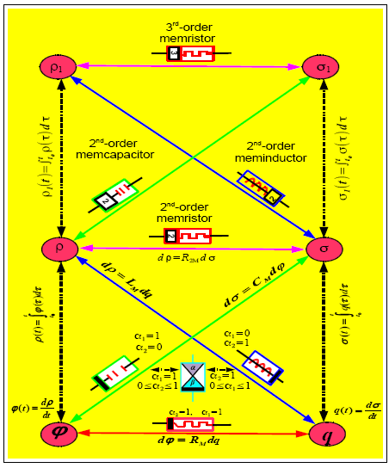

Slide 43
Interpolated Memfractance
The fractance which gives the relationship between flux and charge:
with
Can be considered as an interpolation of the memresistance, inverse
memcapacitance, meminductance and 2nd-order memresistance,
respectively:

Slide 44
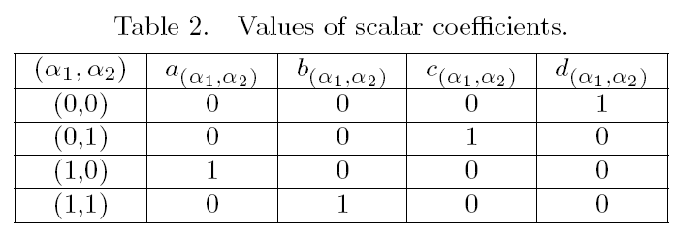
Interpolated Memfractance
The coefficients a, b, c, d satisfy the conditions:
Examples of possible coefficients:

Slide 45
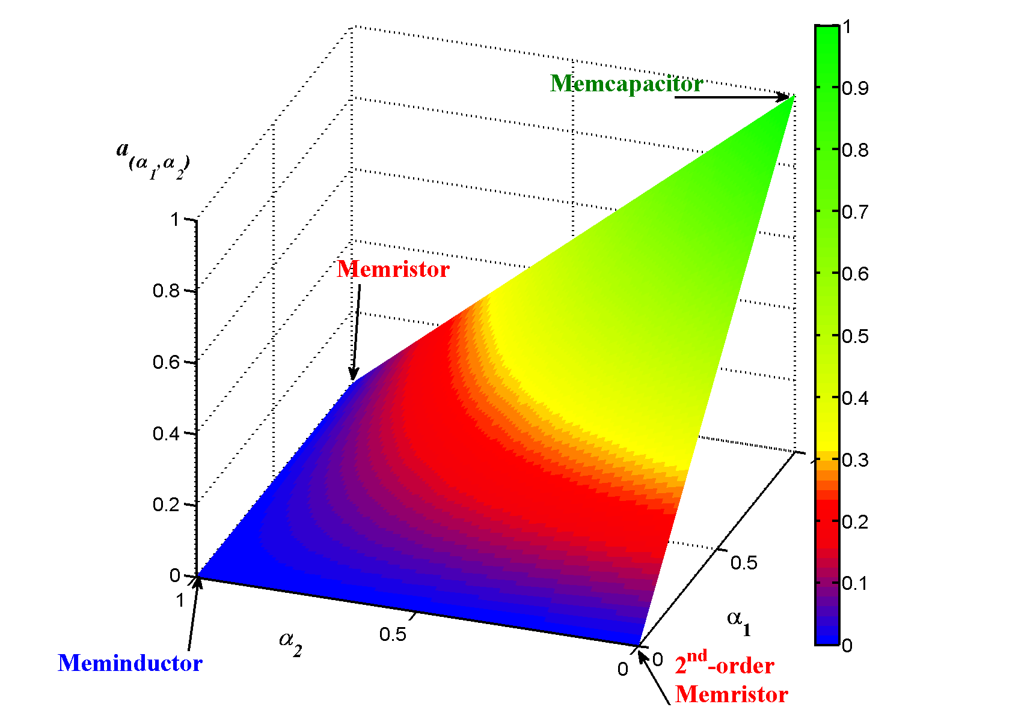
Interpolated Memfractance

Slide 46
Numerical illustrative examples
We consider the following examples:
with and
which gives the time dependant charge
We use the Grünwald-Letnikov’s definition, which is more easy to use in
numerical computations.

Slide 47
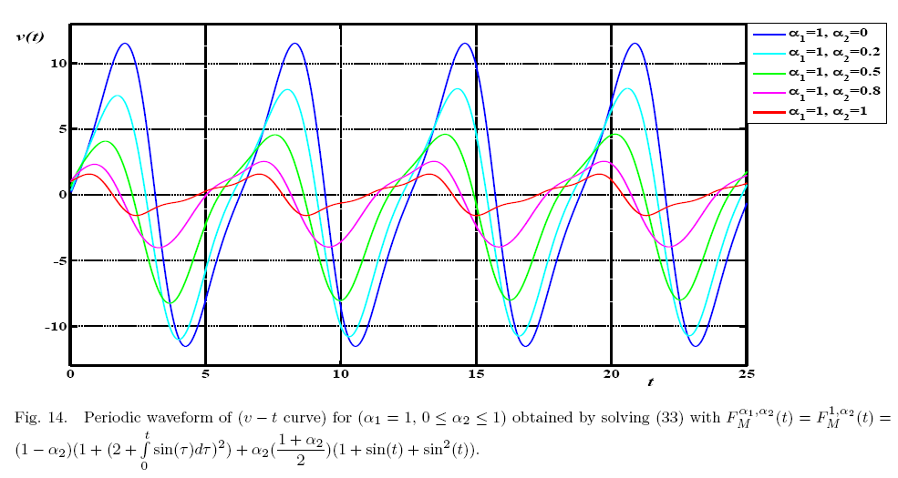
Voltage versus time
Continuous behavior of memfractance between memristor and memcapacitor
memcapacitor
memristor

Slide 48
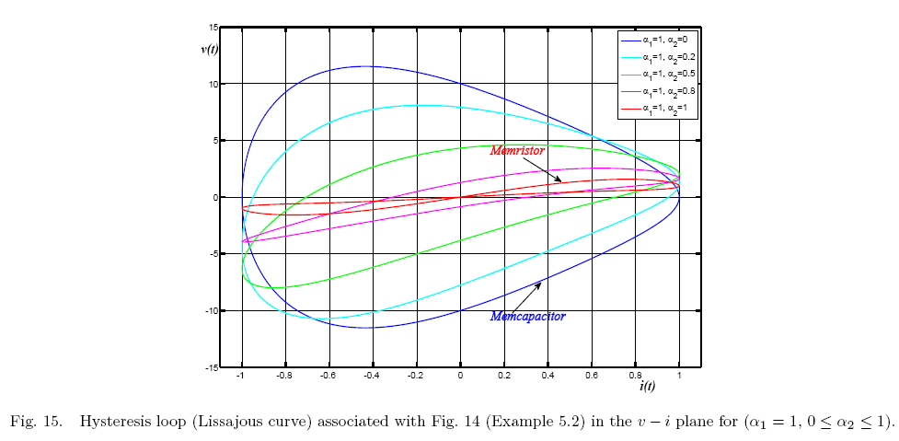
Voltage versus intensity

Slide 49
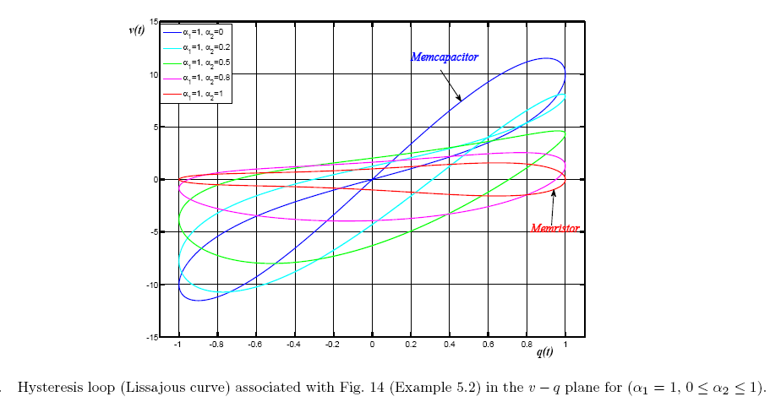
Voltage versus charge

Slide 50
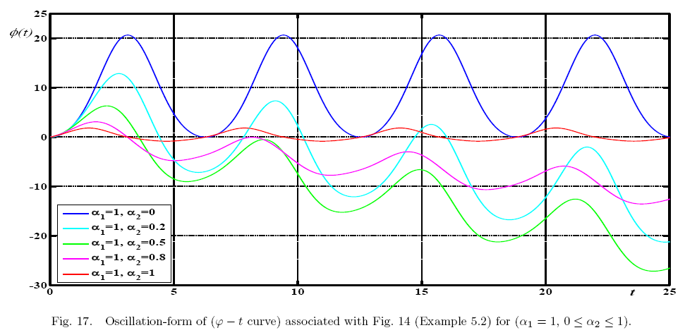
The flux behavior
Interpolation between memristor and memcapacitor

Slide 51
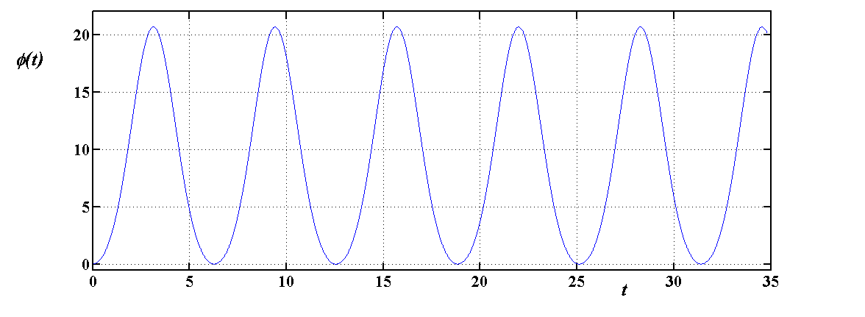
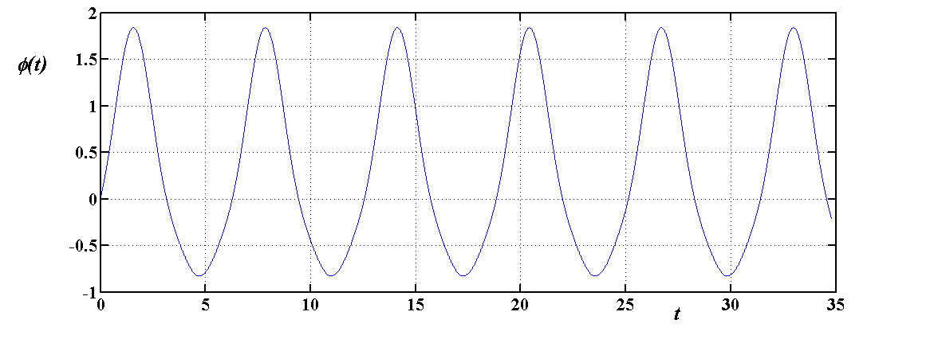
The flux behavior
Interpolation between memristor and memcapacitor
Memristor
Periodic flux
Memcapacitor
Periodic flux

Slide 52
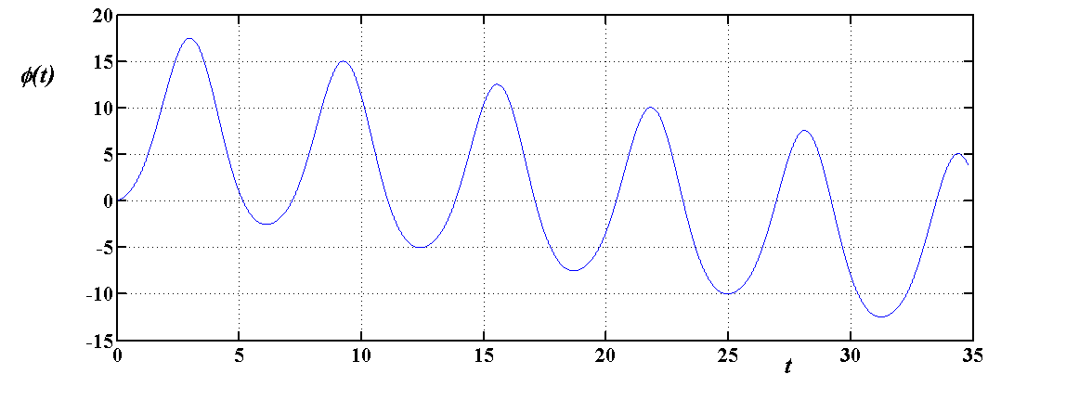
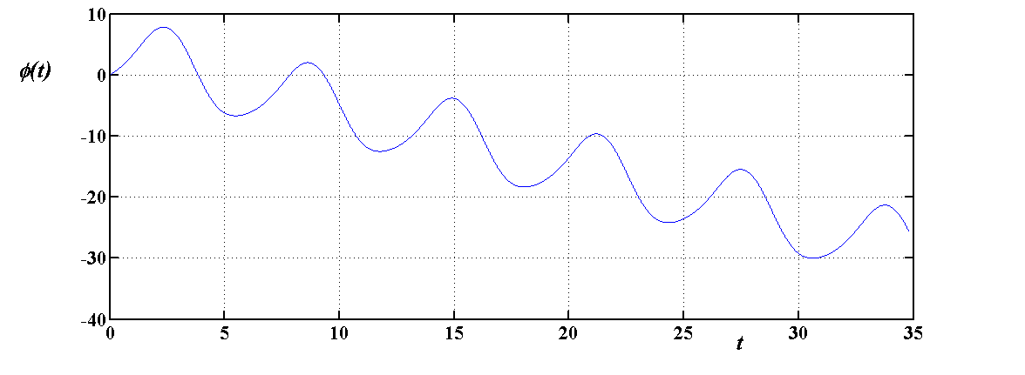
memfractor
Interpolation between memristor and memcapacitor
The flux is divergent
The flux is divergent

Slide 53
Explicit results
For the memristor we choose
We have and
with the approximation
In this case the voltage is periodic
Numerical computations are in good agreement with this approximation.

Slide 54
Explicit results
However the flux can be increasing or decreasing due to the blue and red part of the formula.

Slide 55
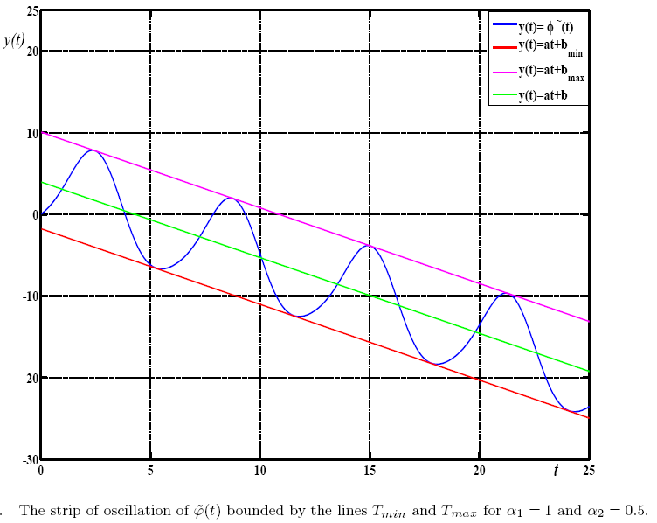
The flux behavior
The flux is bounded in a band of oscillation

Slide 56
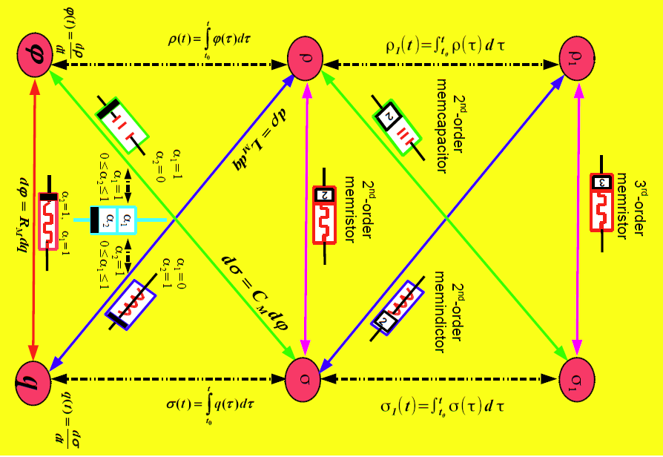
Generalization

Slide 57
A periodic table of circuit elements

Slide 58
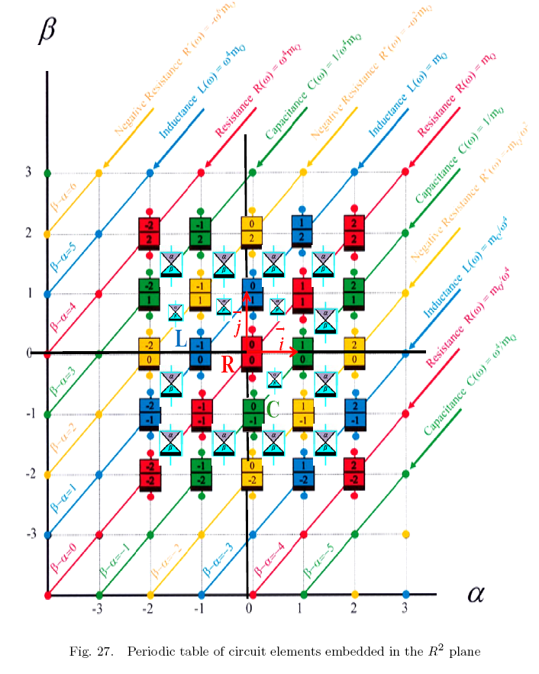

Slide 59


Thank you for your memoristable attention

Slide 60
Brain-like computers

Slide 61
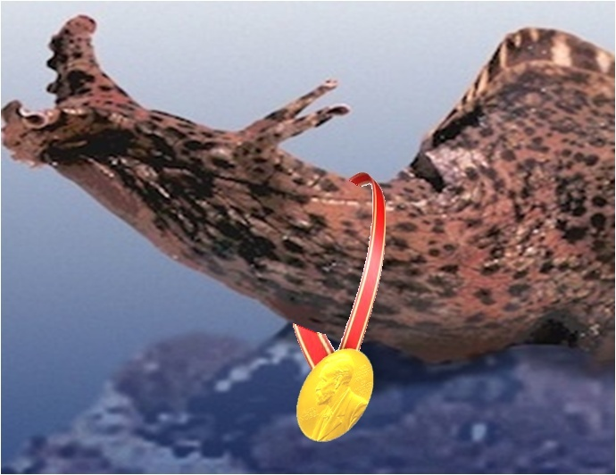
Aplysia with a Nobel Prize Medal

Slide 62

Nobel Prize 2000

Slide 63
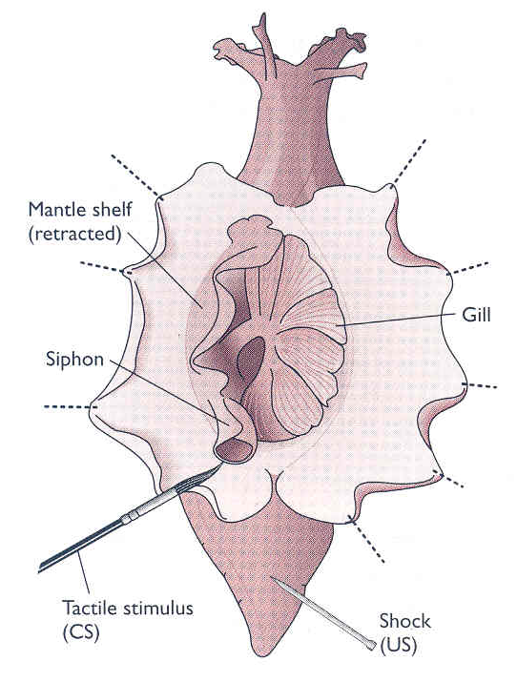
Genus Aplysia: gastropod molluscs called
sea hare or rabbit marine

Slide 64
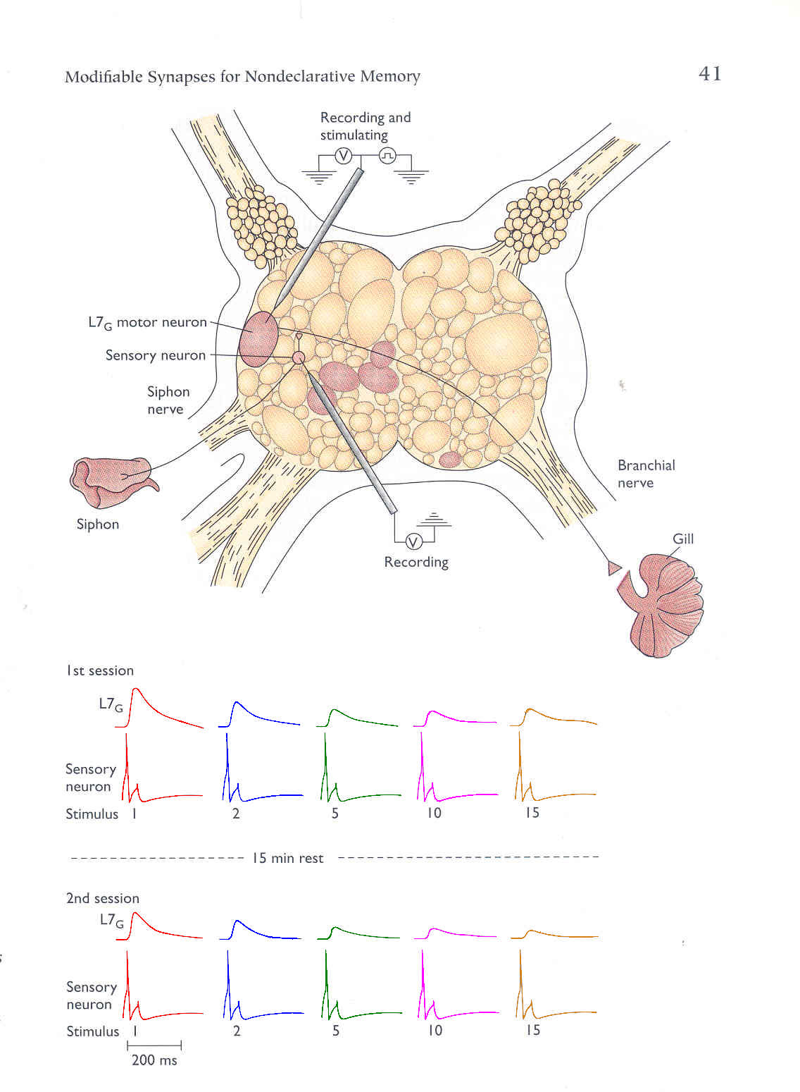
Example of Déjà vu Response of the Aplysia
Excitation
Response

Slide 65
Déjà vu response
Déjà vu response is
learning to recognize
and ignore benign
and boring stimulus.

Slide 66
(a)
L7_{G}
Sensory Neuron
Stimulus
(b)
(c)
i(t), Amps
i
+
20
1
2
3
4
5
v(t)
+
v
6
_
15
7
8
_
9
10
10
11
12
13
14
5
15
q
0
10
20
30
40
50
60
70
80
90
100
110
120
130
140
150
15
t, seconds
14
13
v(t), Volts
10
11
12
8
9
5 seconds
area = 50
6
7
Slope =
5
1
10
1
2
3
5
6
7
8
9
10
11
12
13
14
15
4
(G = Siemens)
3
8
2
Slope = 2 (G = 2 Siemens)
1
ϕ
0
750
0
0
10
20
30
40
50
60
70
80
90
100
110
120
130
140
150
t, seconds

Slide 67
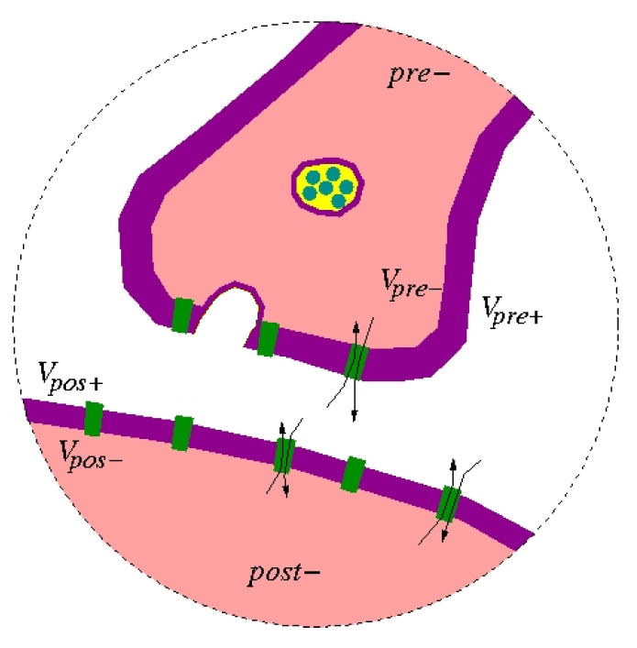

Slide 68
Synapses
are
Memristor!

Slide 69
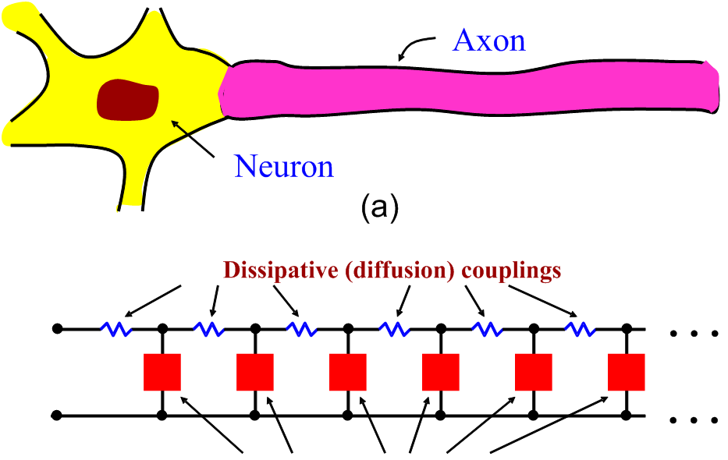
Hodgkin-Huxley Cells

Slide 70

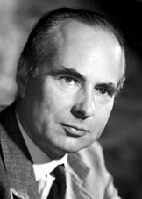
Alan Hodgkin
Andrew Huxley

Slide 72
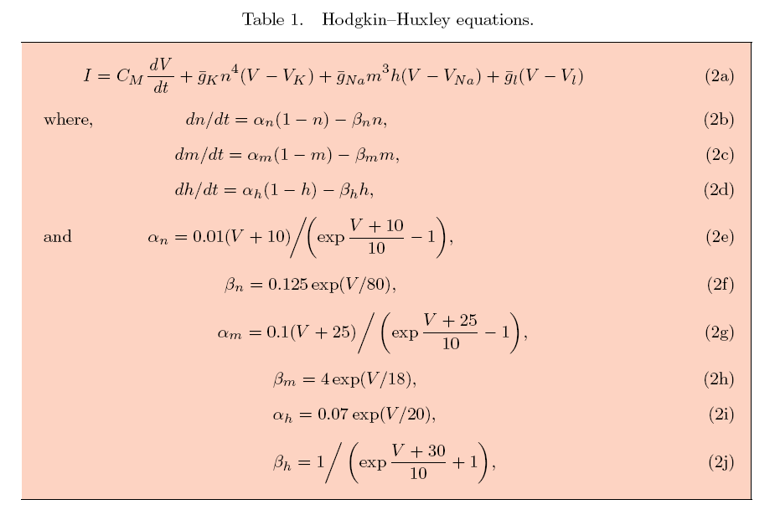

Slide 73
Axon Behaves like a Very large Inductance
Hodgkin and Cole were shocked to find the small-signal ac impedance they had measured from the axon membrane of squids had a gigantic inductance (~ 5 Henrys).

Slide 74
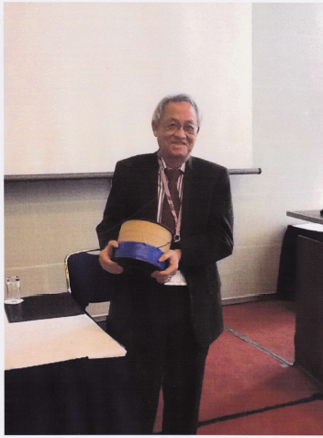
Leon Chua carrying a
1 Henry inductor

Slide 75
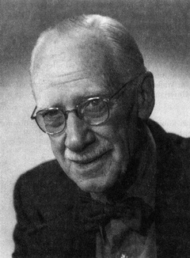
The suggestion of an inductive reactance anywhere in the system was shocking to the point of being unbelievable.
K. S. Cole
Membranes, Ions, and Impulses
University of California
Press , 1972.
Kenneth Cole

Slide 76
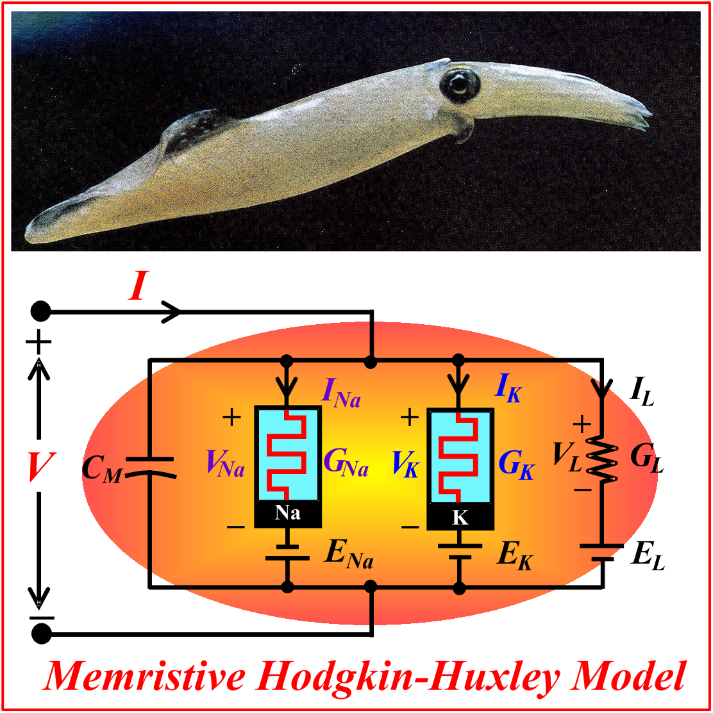

Slide 77
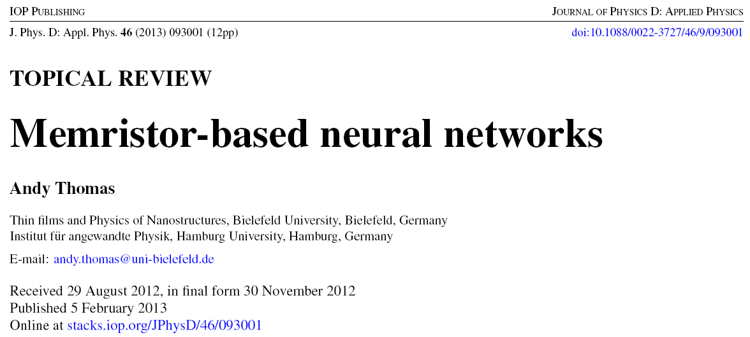
Recent researches (2013)
Interpolation entre un memristor et un memcapacitor

Slide 78
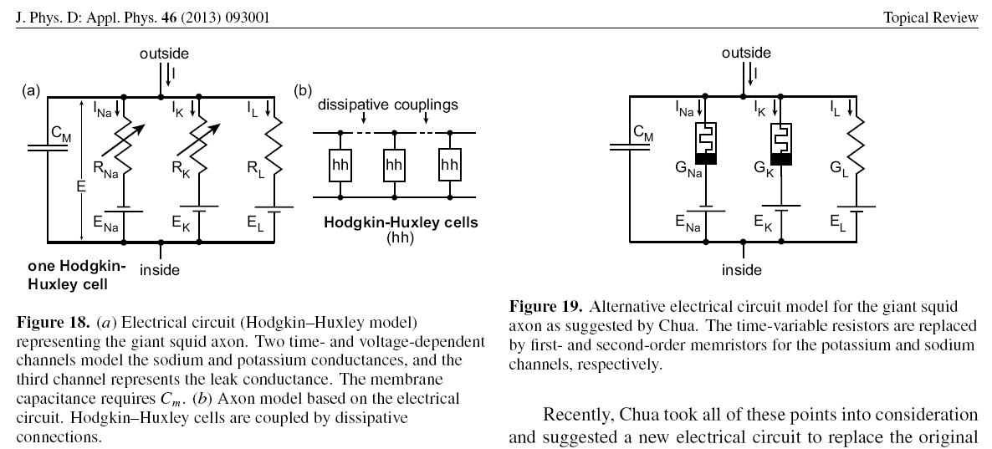
Recent researches (2013)

Slide 79
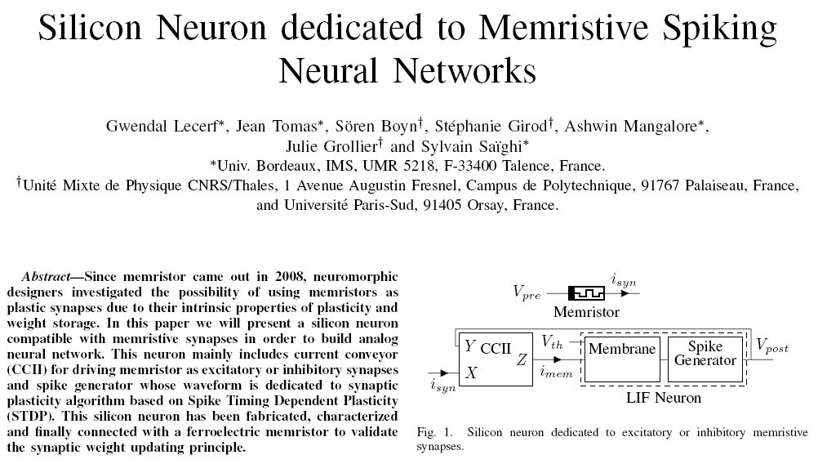
Silicon Neuron (2014)

Slide 80
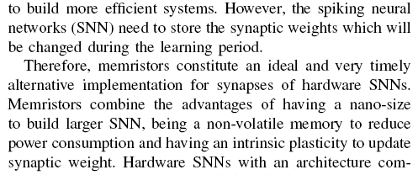
Memristor working as synapse (2014)

Slide 81
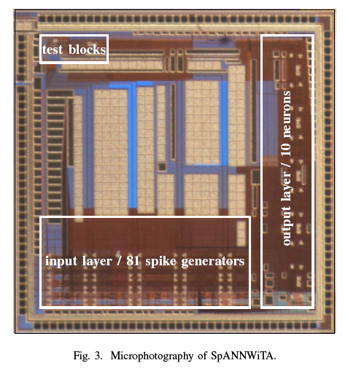
Memristor working as synapse

